Slide 1
Family Performance
Consulting on Website

Slide 2
3 Tasks
Comparison of two potential landing pages
Workflow improvement (new customers)
Improve usability of the website (ease of use)

Slide 3
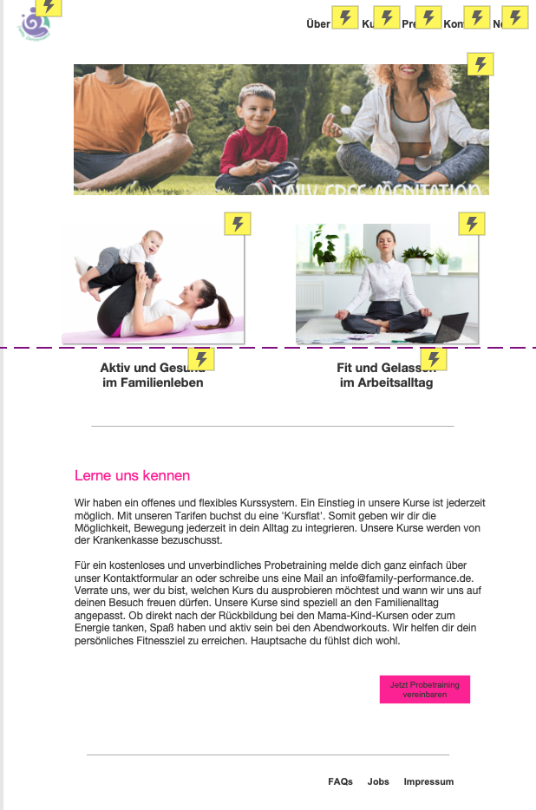
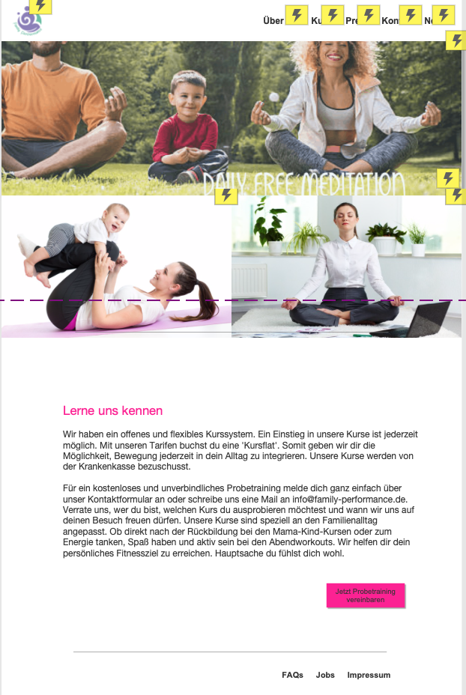
The first task was to compare two possible landing pages. Two identical prototypes were created and compared. For the comparison, the test subjects (existing customers) should complete selected test tasks and then subjectively evaluate the website (MeCue) on different scales.
1. Task
More white space
→ Images stay within the fold
Full-screen images:
→ Images exceed the above-the-fold- range

Slide 4
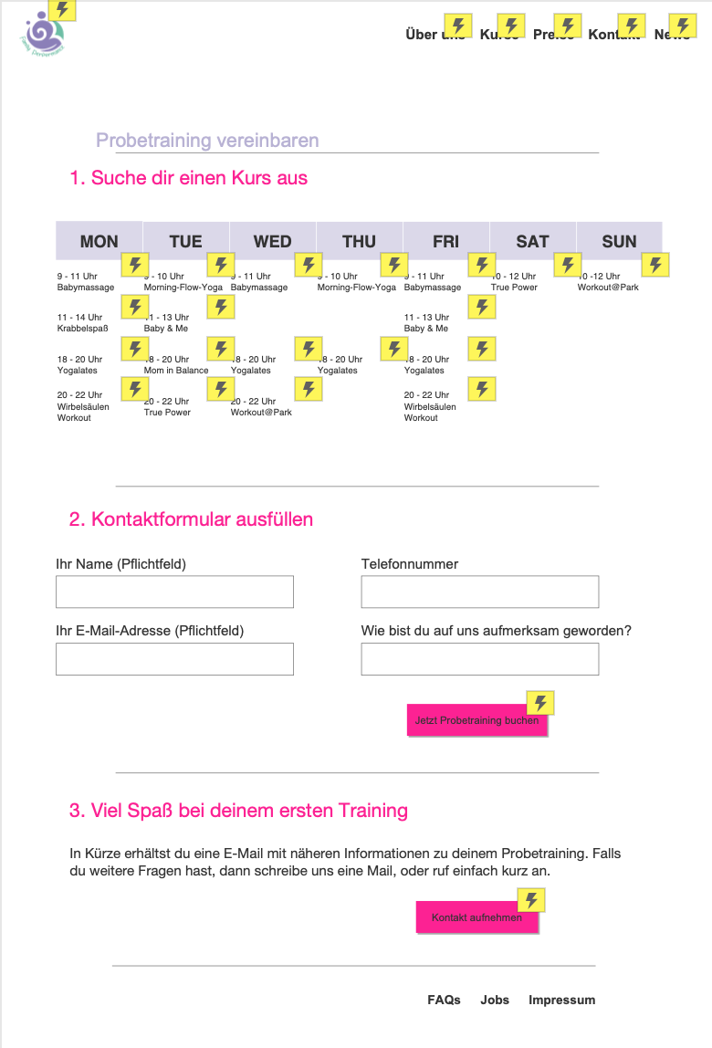
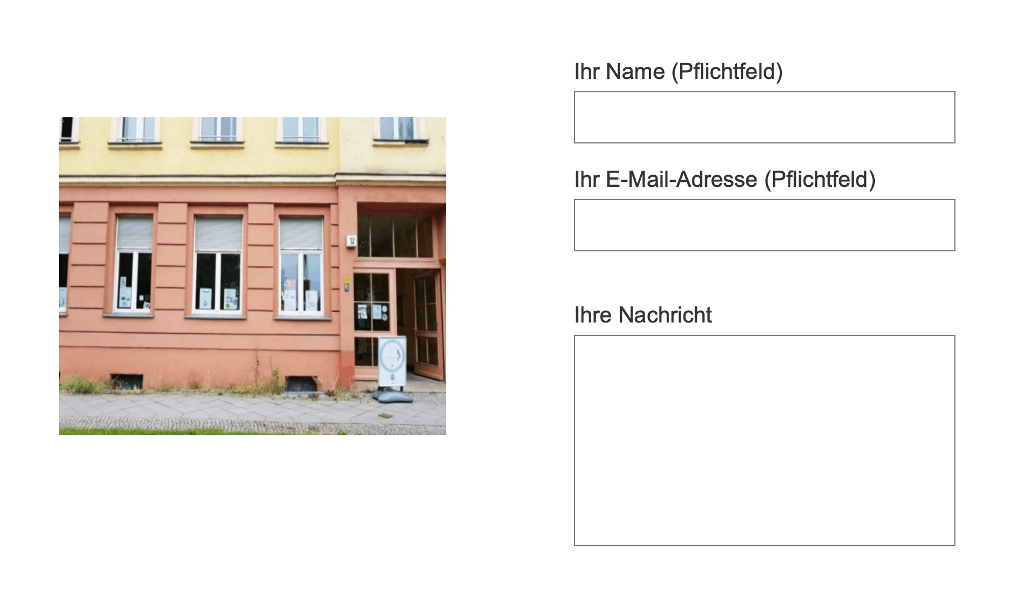
On the existing website, new customers need to contact the studio via the contact form in order to schedule a trial training. As an alternative solution, I have created a simple workflow that allows customers to register for a trial training on their own.
2. Task
Existing contact field to schedule trail training
2 step process to schedule trail training

Slide 5
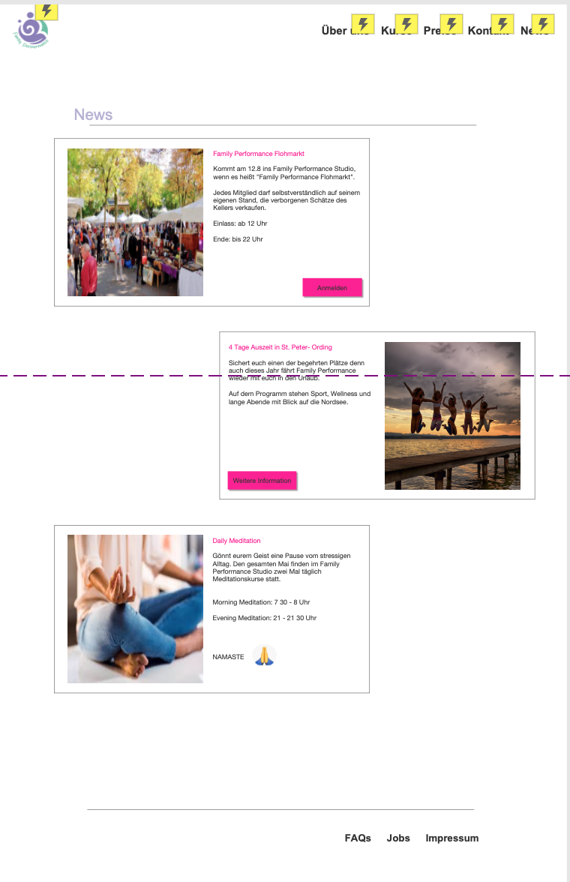
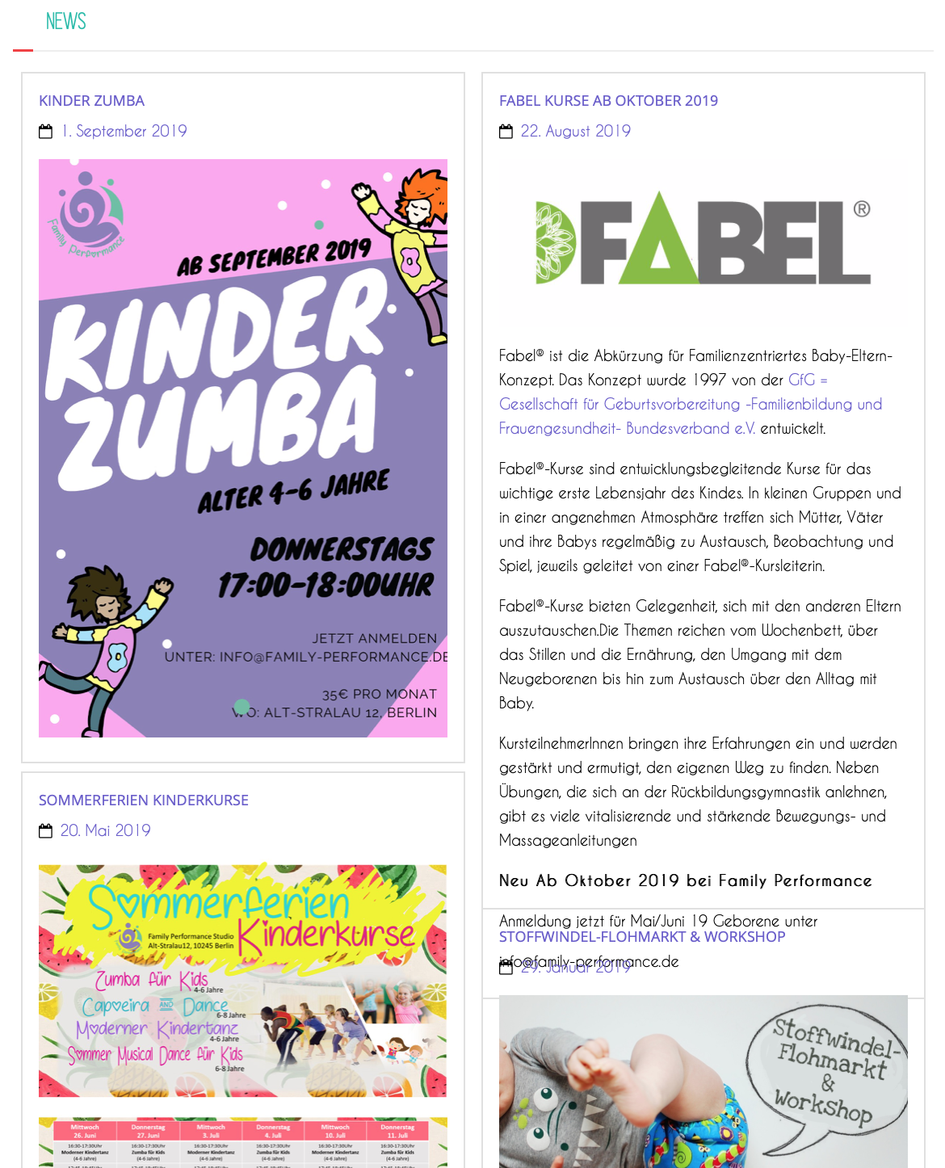
The goal is to increase the comprehensibility of the website. The current "news" section looks cluttered and it is difficult to see the chronological order of the news.
3. Task
Existing website
→ Events are tiles on the webpage and are not automativally arraged
More white space and clear top to buttom order of events

Slide 6
Greenhaus by Vattenfall
Solar App: Persona, Low & High Fidelity Prototyp

Slide 7
Hardware Entwicklung
Greenhaus
HR Managerin
Vattenfall
Digitale Produktentwicklung
Greenhaus
Projektleiter
Greenhaus
Managing Director
Vattenfall
https://www.waz.de/wirtschaft/wie-der-stromkonzern-vattenfall-start-ups-unterstuetzt-id12188992.html

Slide 8
2 Tasks
Improve current planing tool (clutter, old design, bad usability)
Simplify workflow and steps
Persona & user stories (Workshop)
Heuristic evaluation & prototyp
1. Iteration
Test goals and evaluation design
2. Iteration
Final tool

Slide 9
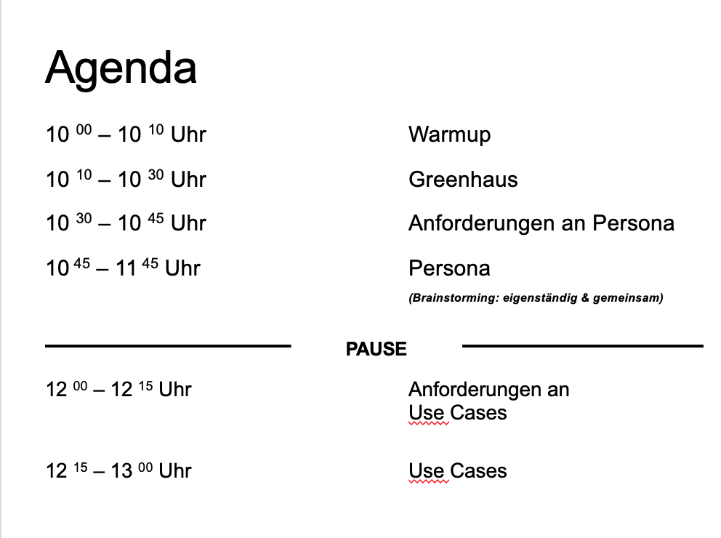
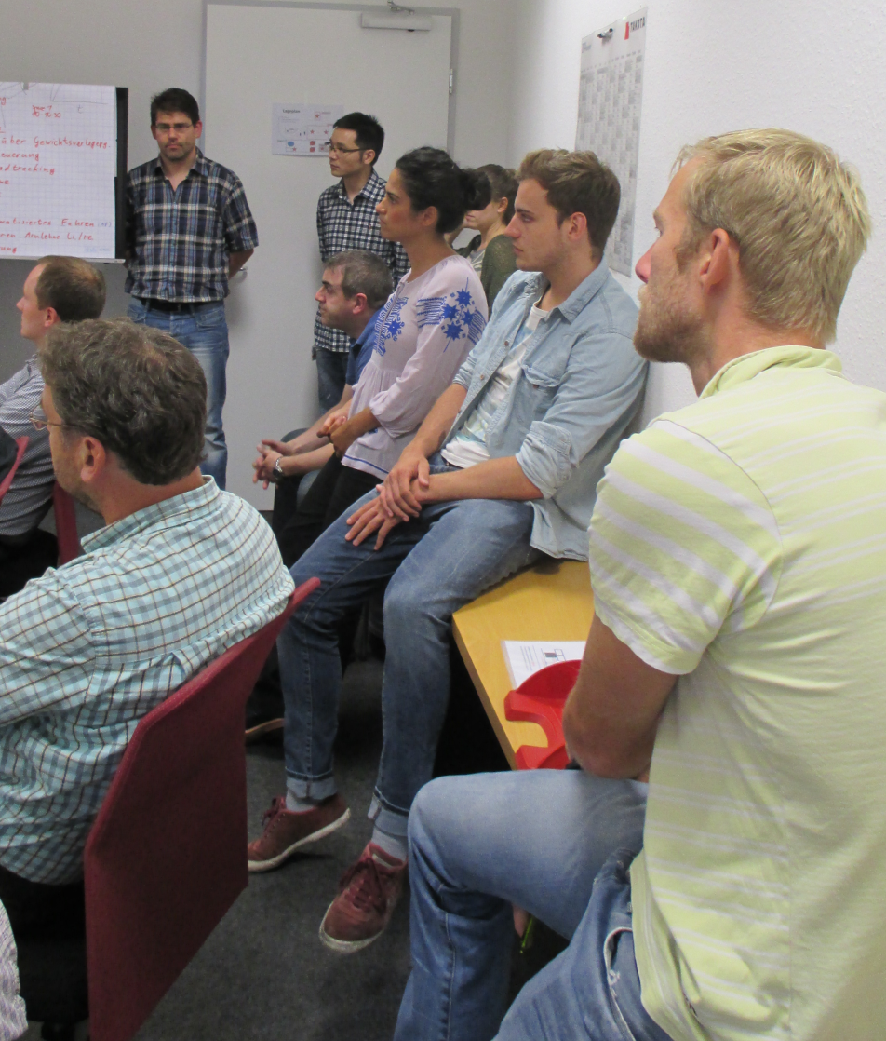
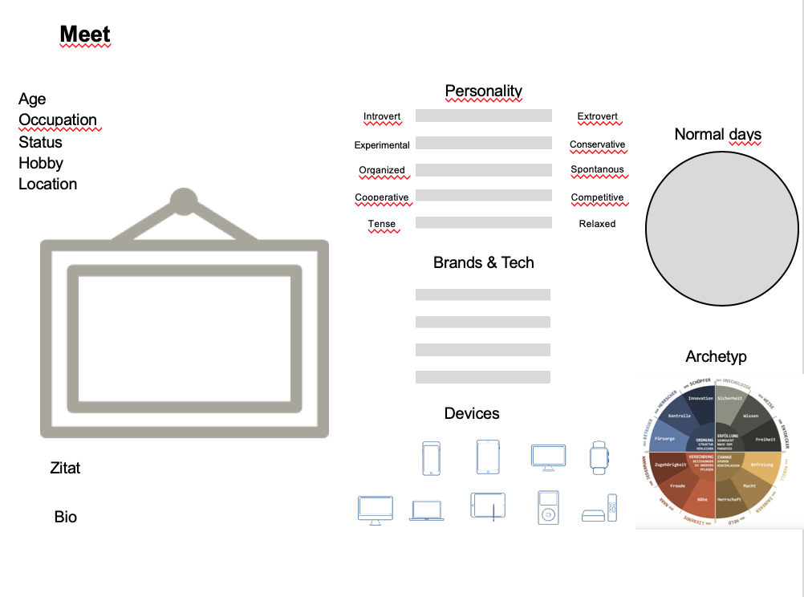
Persona & Use Cases Workshop

Slide 10
Christoph Teege
Age
Occupation
Status
Location
Archetype
Hobby
31
Teacher
Married
Berlin
Ruler
Hiking
Personality
Technology
Introvert
Extrovert
Internet
Experimental
Conservative
Social Media
Organized
Spontanious
Apps
Compromize
Competitive
Software
Tense
Releaxed
Brands
Bio
Christoph is a career starter and expects the birth of his son shortly. He is very anxious to invest his money well so that he can enjoy a carefree life with his family.
Even if he doesn't know much about technology, he uses the Internet a lot and surfs the net. He also has a Facebook account, which he regularly checks.
„ There are many smart ways to invest your money. Renewable energy is not only good for the environment, but also for my family.“
„ There are many smart ways to invest your money. Renewable energy is not only good for the environment, but also for my family.“

Slide 11
Former planing tool

Slide 12
2. Iteration: Test design
Between-Subjects:
− old vs. new tool
Dependent variables :
− Workload (NASA TLX)
− UX (meCUE)
− Additional comments
Further evaluation:
− KPIs (conversion rate, drop-off rate & chat requests)

Slide 13
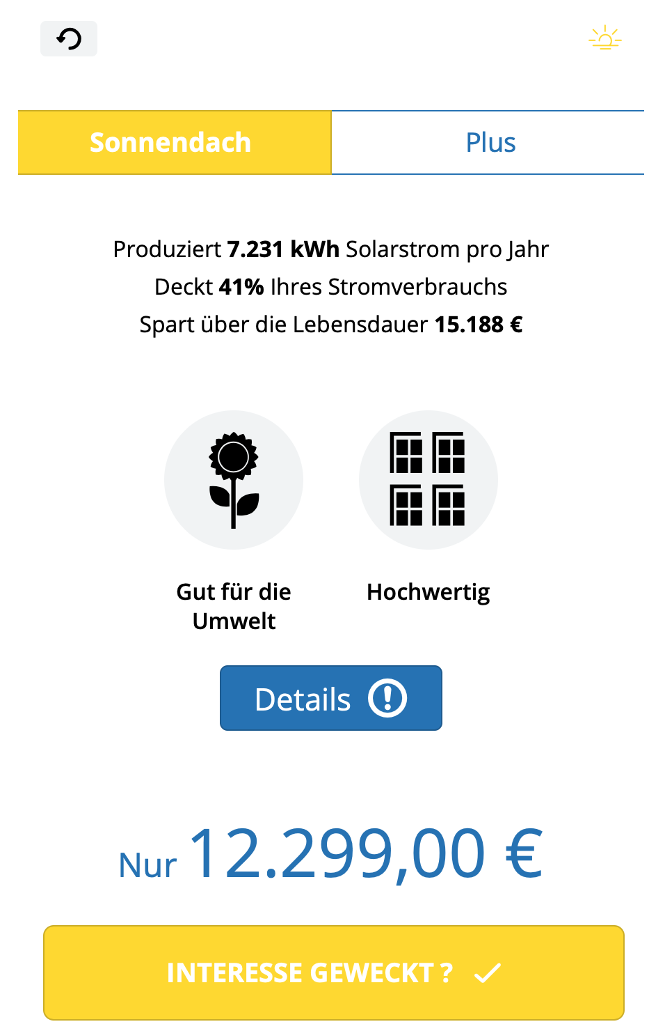
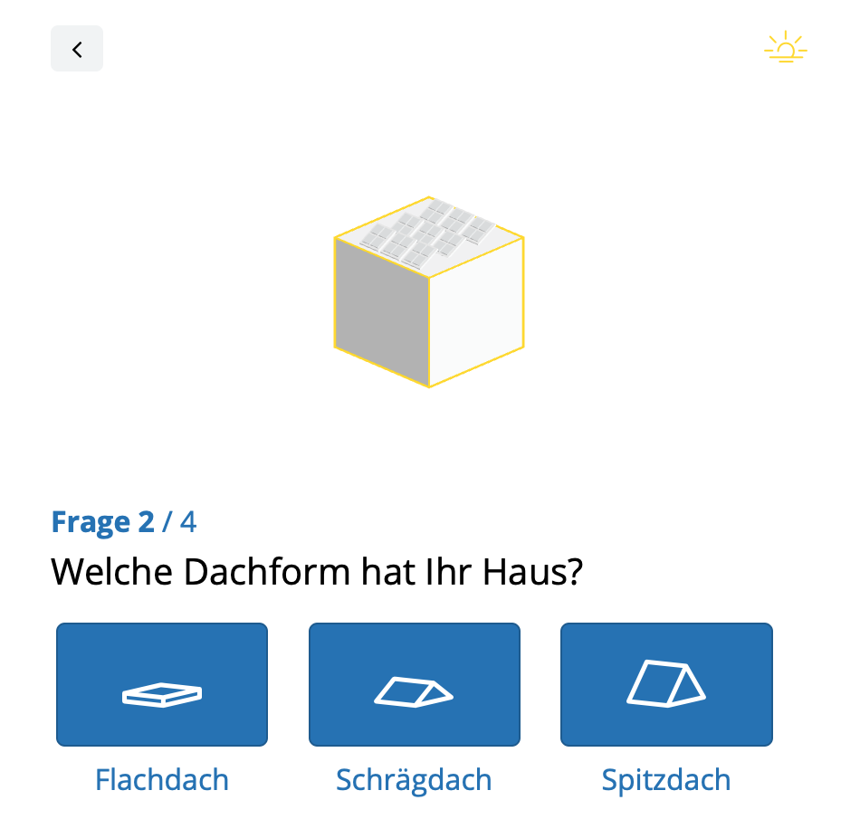
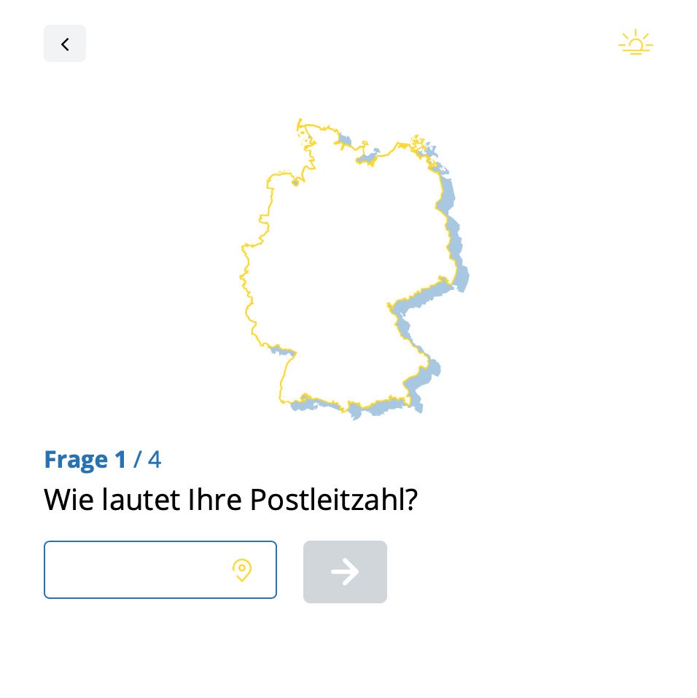
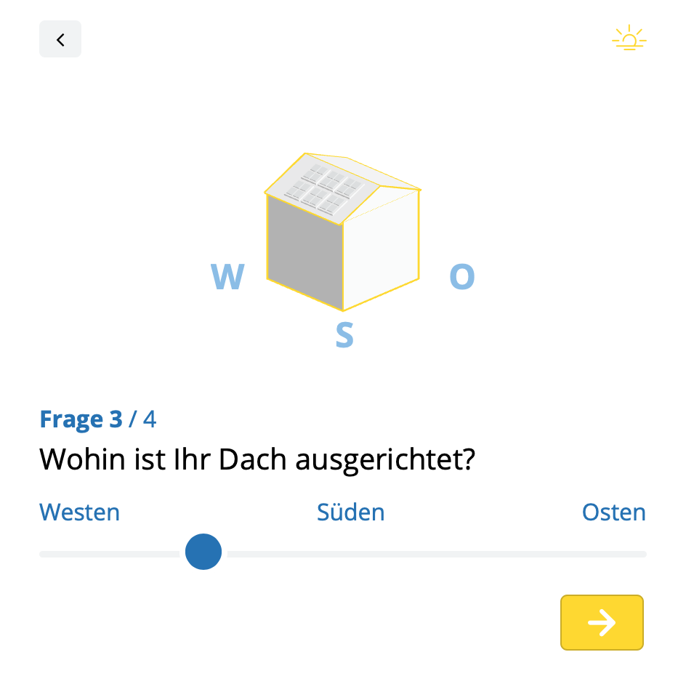
Finales Planungstool

